Slide 1
Formal Methods in Software Engineering
FMSE
/ 23

Slide 2
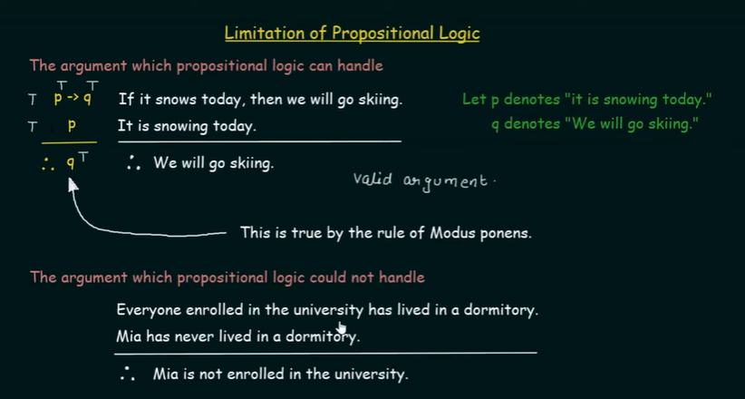
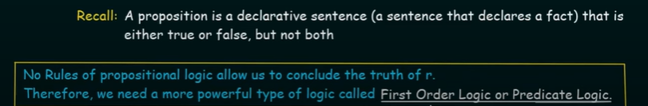

Slide 3
First Order Logic
Philosophers have developed First Order Logic to overcome the limitations of propositional logic. Actually First Order Logic is an advanced form of propositional logic.
Its domain of variables is usually very large and infinite, and distinguished from propositional logic by its use of quantified variables.
It additionally covers the predicates, which resembles a function that may either be true or false.
First Order Logic allows reasoning about properties that are shared by many objects through the use of variables.
FMSE
/ 23

Slide 4
First Order Logic or Predicate Logic
In traditional grammar, a predicate is one of the two main parts of a sentence the other being the subject, which the predicate modifies.
“Sky is blue” Sky acts as the subject, and is blue acts as the predicate.
Brother(Ali, Ahmad), lessThan(2, 3) The predicate is much like a verb phrase.
In linguistic semantics, a predicate is an expression that can be true of something
FMSE
/ 23

Slide 5
First Order Logic
First-order logic (FOL) is the logic to speak about objects, which are the domain of discourse (variables range over individuals) or universe.
Objects Example: FMSE, John, CS102, etc.
FOL is concerned about properties of these objects and relations over objects.
FOL contains predicates, quantifiers and variables. Relations/Predicates Example: isMan(John), hasClass(FMSE, CS102), isKindOf(apple, fruit)
FOL has functions including constants that denote objects. Example; Philosopher(a) → Scholar(a)
FMSE
/ 23

Slide 6
FOL Quantifiers
logical connectives: ¬, ∨, ∧, ⇒, ⇔
Quantifiers:
Universal: ∀x , King(x ) ∧ Greedy(x ) ⇒ Evil(x )
Existential: ∃y : (isFather (y, John))
Evil king john rules England in 1200
Objects: John, England, 1200 Property: evil, king Relation: ruled
FMSE
/ 23

Slide 7
Properties of Quantifiers
∀x∀y is the same as ∀y∀x
∃x∃y is the same as ∃y∃x
∃x∀y is the same as ∀y∃x
Quantifiers Daulity:
∀x Likes(x , IceCream) ≡ ¬∃x¬ Likes(x , IceCream)
∃x Likes(x , MangoIceCream) ≡ ¬∀x¬ Likes(x , MangoIceCream)
FMSE

Slide 8
Properties of Quantifiers
Equivalence
∃xP is equivalent to ¬∀x¬P
¬∃x¬P is equivalent to ∀xP
∃x¬P is equivalent to ¬∀xP
¬∃xP is equivalent to ∀x¬P
FMSE

Slide 9
FOL Formulas
The set of formulas (also called well-formed formulas or wffs) is inductively defined by the following rules:
1
Predicate symbols. If P is an n−ary predicate symbol and t₁, . . . , t_{n}
are terms then P(t₁, . . . , t_{n}) is a formula.
Equality. If the equality symbol is considered part of logic, and t₁
and t₂ are terms, then t₁ = t₂ is a formula.
Negation. If ϕ is a formula, then ¬ϕ is a formula.
2
3
4
Binary connectives. If ϕ and ψ are formulas, then (ϕ → ψ is a
formula. Similar rules apply to other binary logical connectives.
Quantifiers. If ϕ is a formula and x is a variable, then ∀xϕ (for all
x, ϕ holds) and ∃xϕ (there exists x such that ϕ are formulas.
5
FMSE

Slide 10
Expressing Facts in FOL
Lucy is a professor
All professors are people. John is the dean.
Deans are professors.
Everyone is a friend of someone.
FMSE

Slide 11
Knowledge base in FOL
Lucy is a professor — isProf(lucy)
All professors are people. — ∀x (isProf (x ) → isPerson(x )) John is the dean. — isDean(John)
Deans are professors. — ∀x (isDean(x ) → isProf (x )) Everyone is a friend of someone. — ∀x (∃y (isFriendOf (y, x )))
Question: Is John no friend of Lucy? ¬isFriendOf (John, lucy )?
FMSE

Slide 12
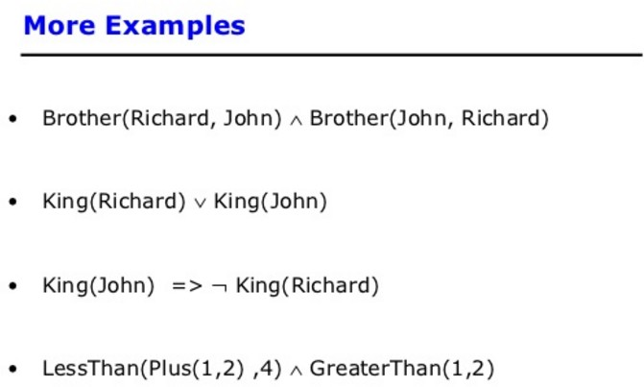
FMSE

Slide 13
Knowledge Engineering Steps
Identify the task.
Assemble the relevant knowledge.
Decide on a vocabulary of predicates, functions, and constants. Encode general knowledge about the domain.
Encode a description of the specific problem instance. Pose queries to the inference procedure and get answers. Debug the knowledge base.
FMSE

Slide 14
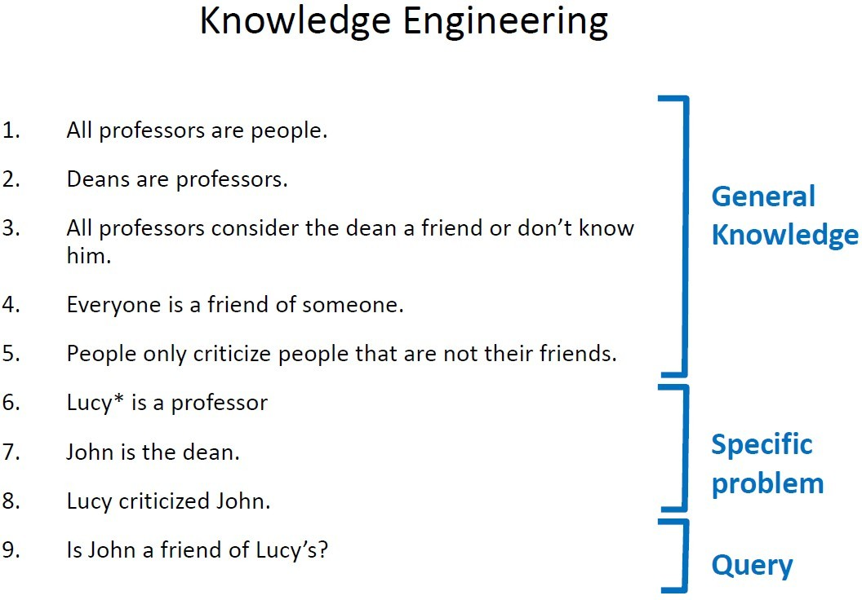
FMSE

Slide 15
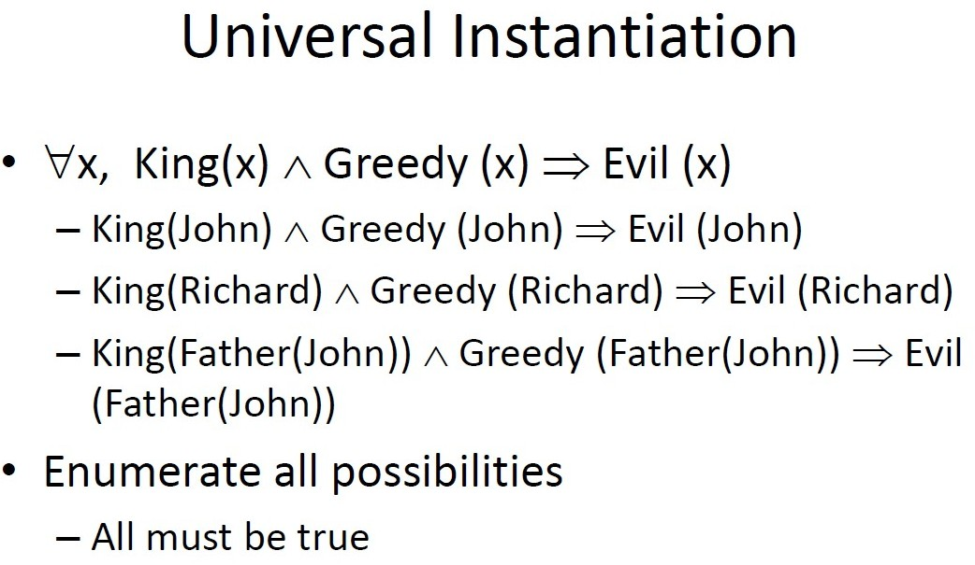
FMSE

Slide 16
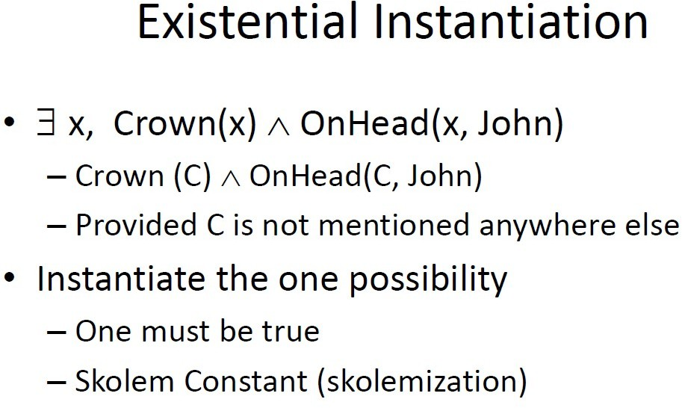
FMSE

Slide 17
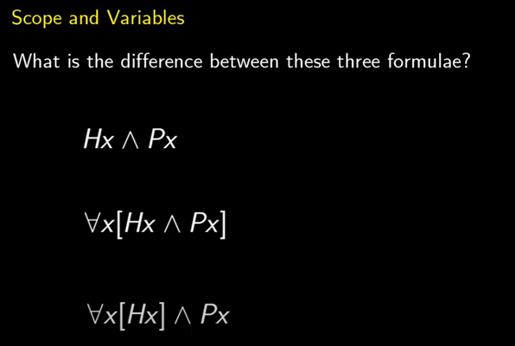

Slide 18
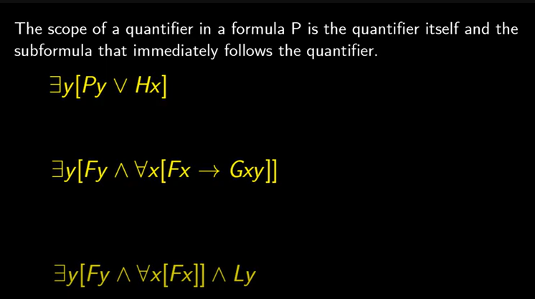

Slide 19
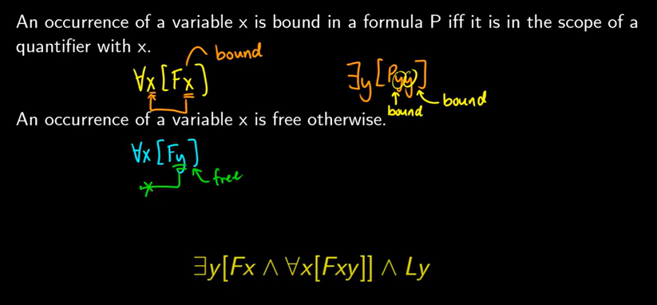

Slide 20
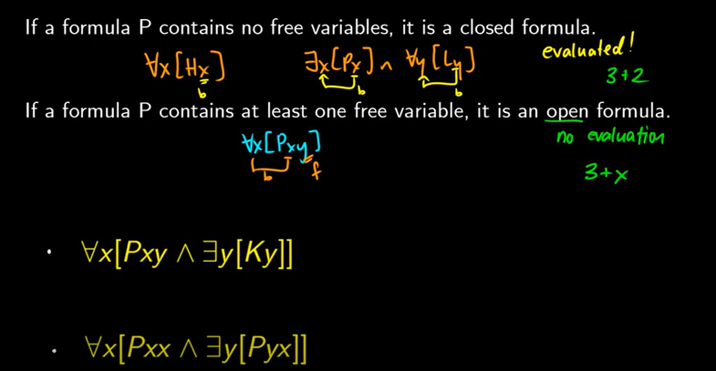
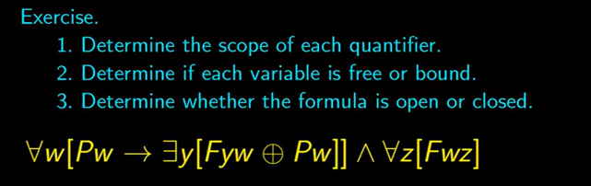

Slide 21
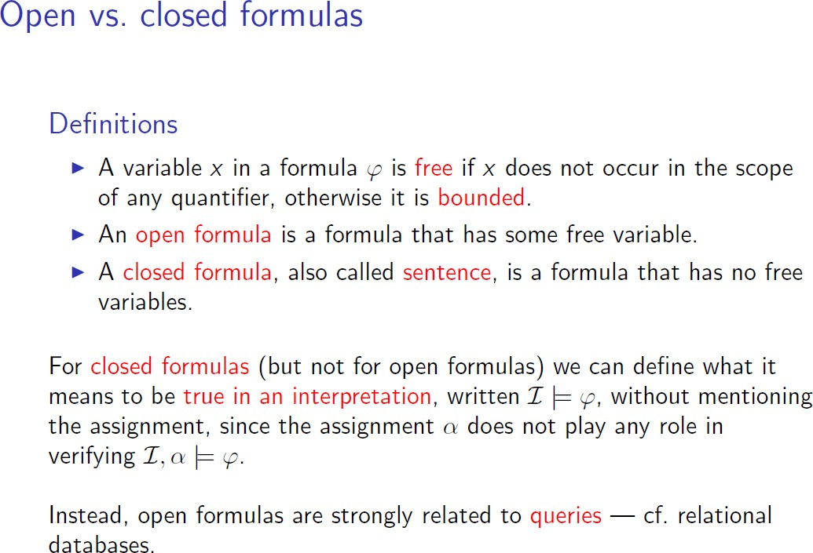
FMSE

Slide 22
Syntax of First Order Logic
Syntax determines which collection of symbols are legal expression.
In First Order Logic, we use Greek letters like ϕ, ψ, χ, Γ, θ etc (instead of using p, q, r as used in Propositional Logic).
In FOL, two types of legal expressions are used.
1
Every variable and constant is a term and term represents objects.
2
If f is an n−ary function and t₁, . . . , t_{n} are terms, then f (t₁, . . . , t_{n} ) is
also a term.
FMSE

Slide 23
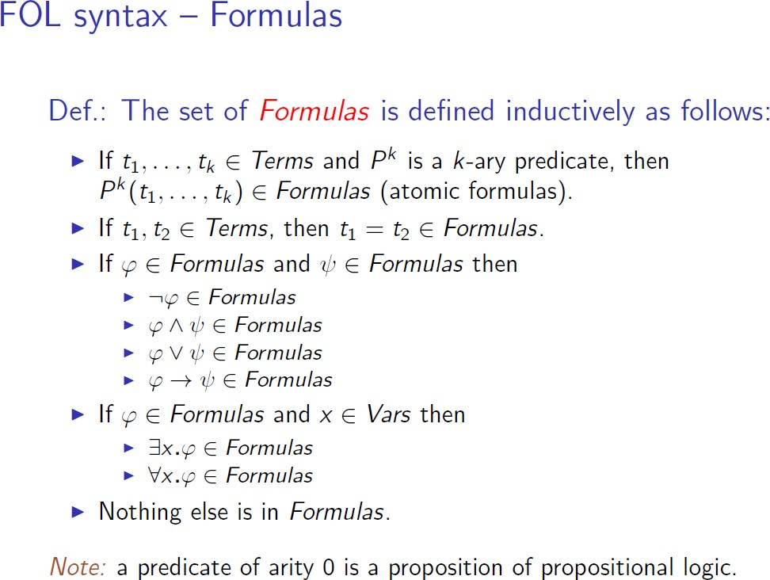
FMSE

Slide 24
Primitive symbols are ¬, ∧, ∃.
Every formula in FOL is built from atomic formula by repeated application of three rules.
Each rule corresponds to a primitive symbol. These three rules are listed below:
1
If ϕ is a formula then so is ¬ϕ.
If ϕ and ψ are formulas the so is ϕ ∧ ψ .
If ϕ is a formula, then so is ∃xϕ for any variable x .
2
3
FMSE

Slide 25
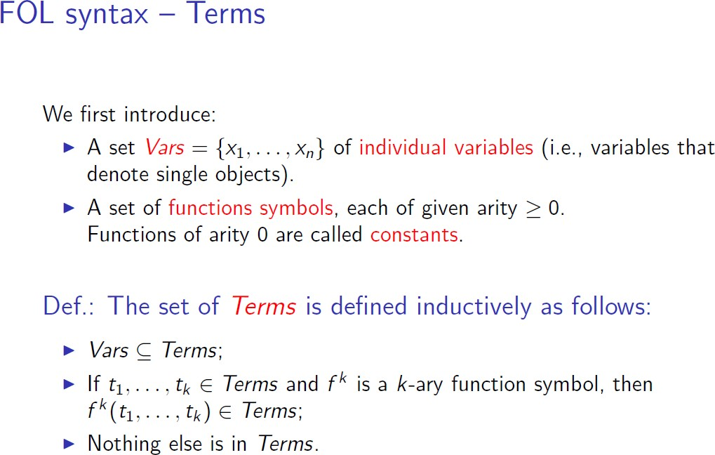
FMSE

Slide 26
Thanks!
FMSE

